Slide 1

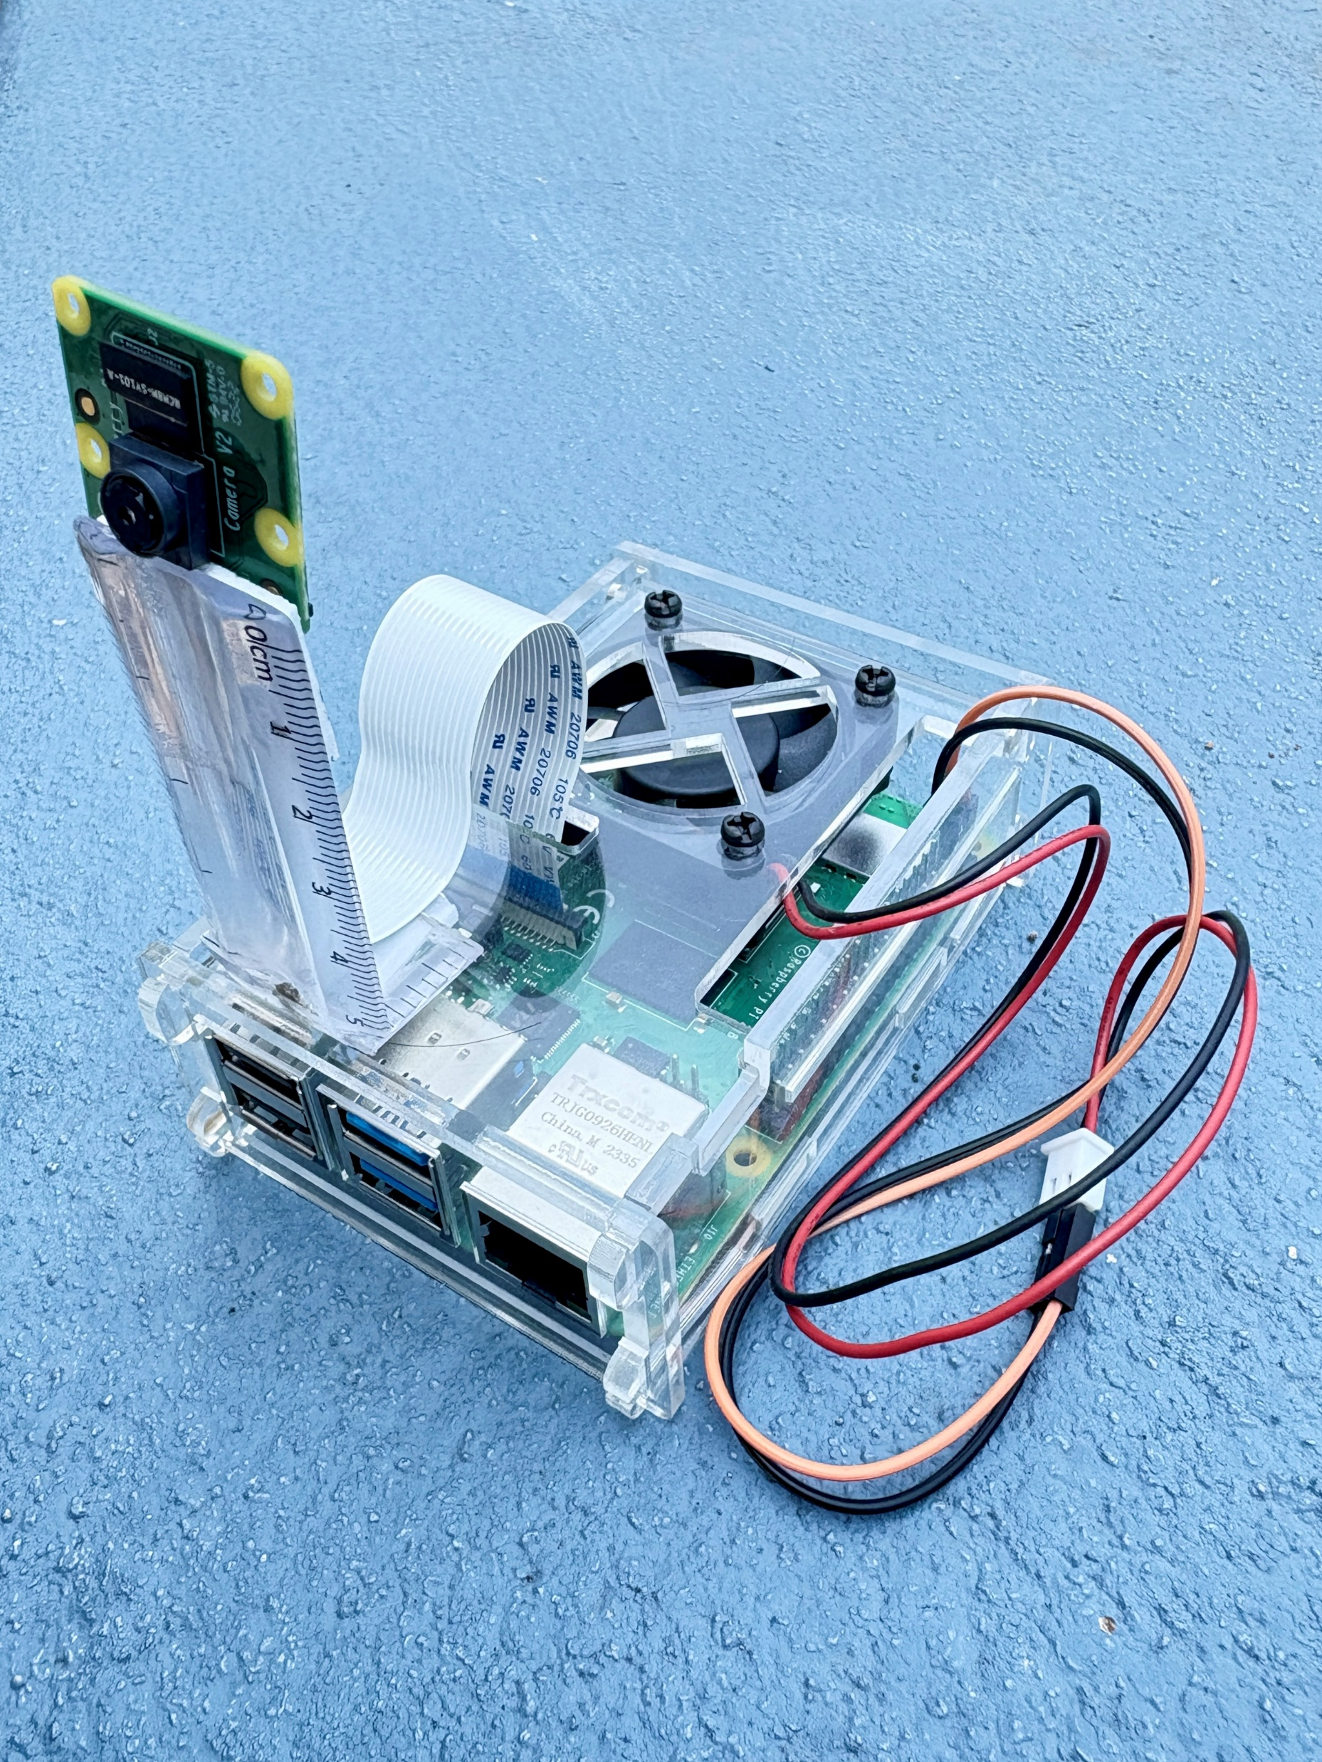
AI-Based Crowded Area Risk Prediction System
Mohan Babu University
Team members:
M. Dileep Reddy - CSE
N. Herambudu - CSE
B.M.D Sameer - CSE
T. Jyotsna - CSE
A. Rupa Sridevi - CSE
Under the Guidance of
Dr. N. Padmaja
Deputy Dean of Innovations and Patents
Department of ECE

Slide 2
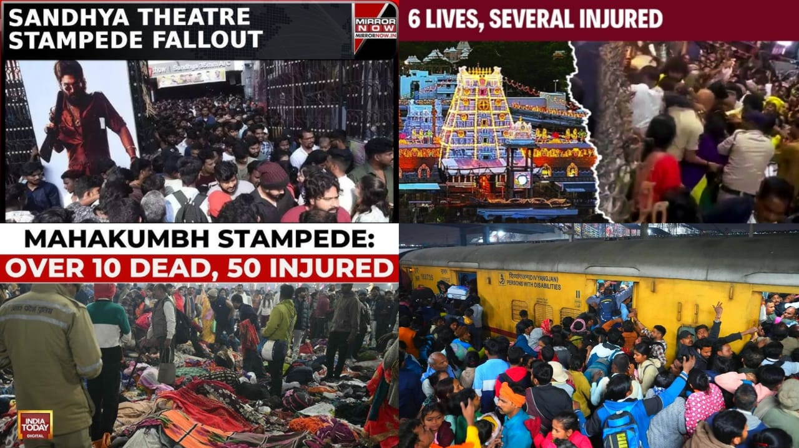
Why This Project?
Problem Statement :
Overcrowding in public spaces can lead to dangerous situations like stampedes, accidents, and panic.
Lack of real-time monitoring systems to prevent such incidents.
Need for Solution :
Early detection of crowd density is crucial to ensure public safety.
A cost-effective, portable, and real-time solution is needed for effective crowd management.

Slide 3
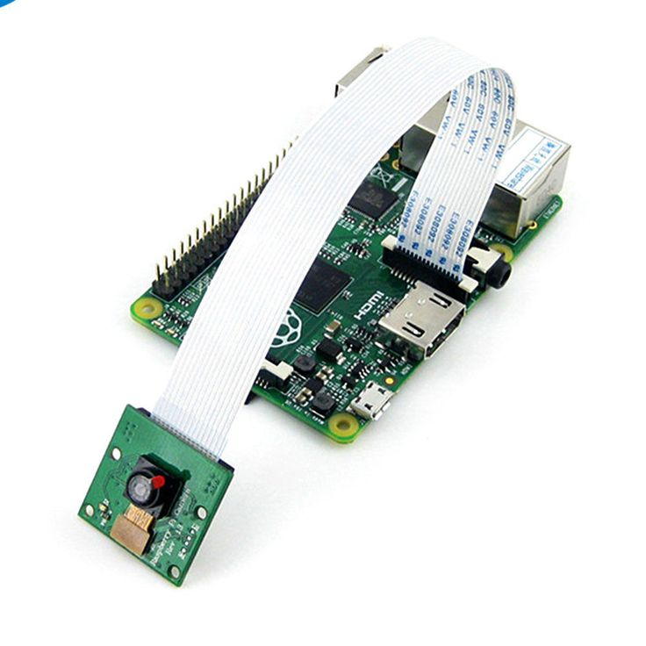
Technology & Hardware Used
Hardware:
Raspberry Pi 4 (4GB/8GB RAM)
Raspberry Pi Camera v2 (or USB Camera)
MicroSD Card (32GB/64GB)
Power Supply (5V, 3A)
Software & Technologies:
YOLOv5s : For real-time object detection.
Flask : For web dashboard and API endpoints.
OpenCV : For image processing and video streaming.
Telepot : For Telegram bot integration.
HTML/CSS/JavaScript : For dynamic web dashboard.

Slide 4
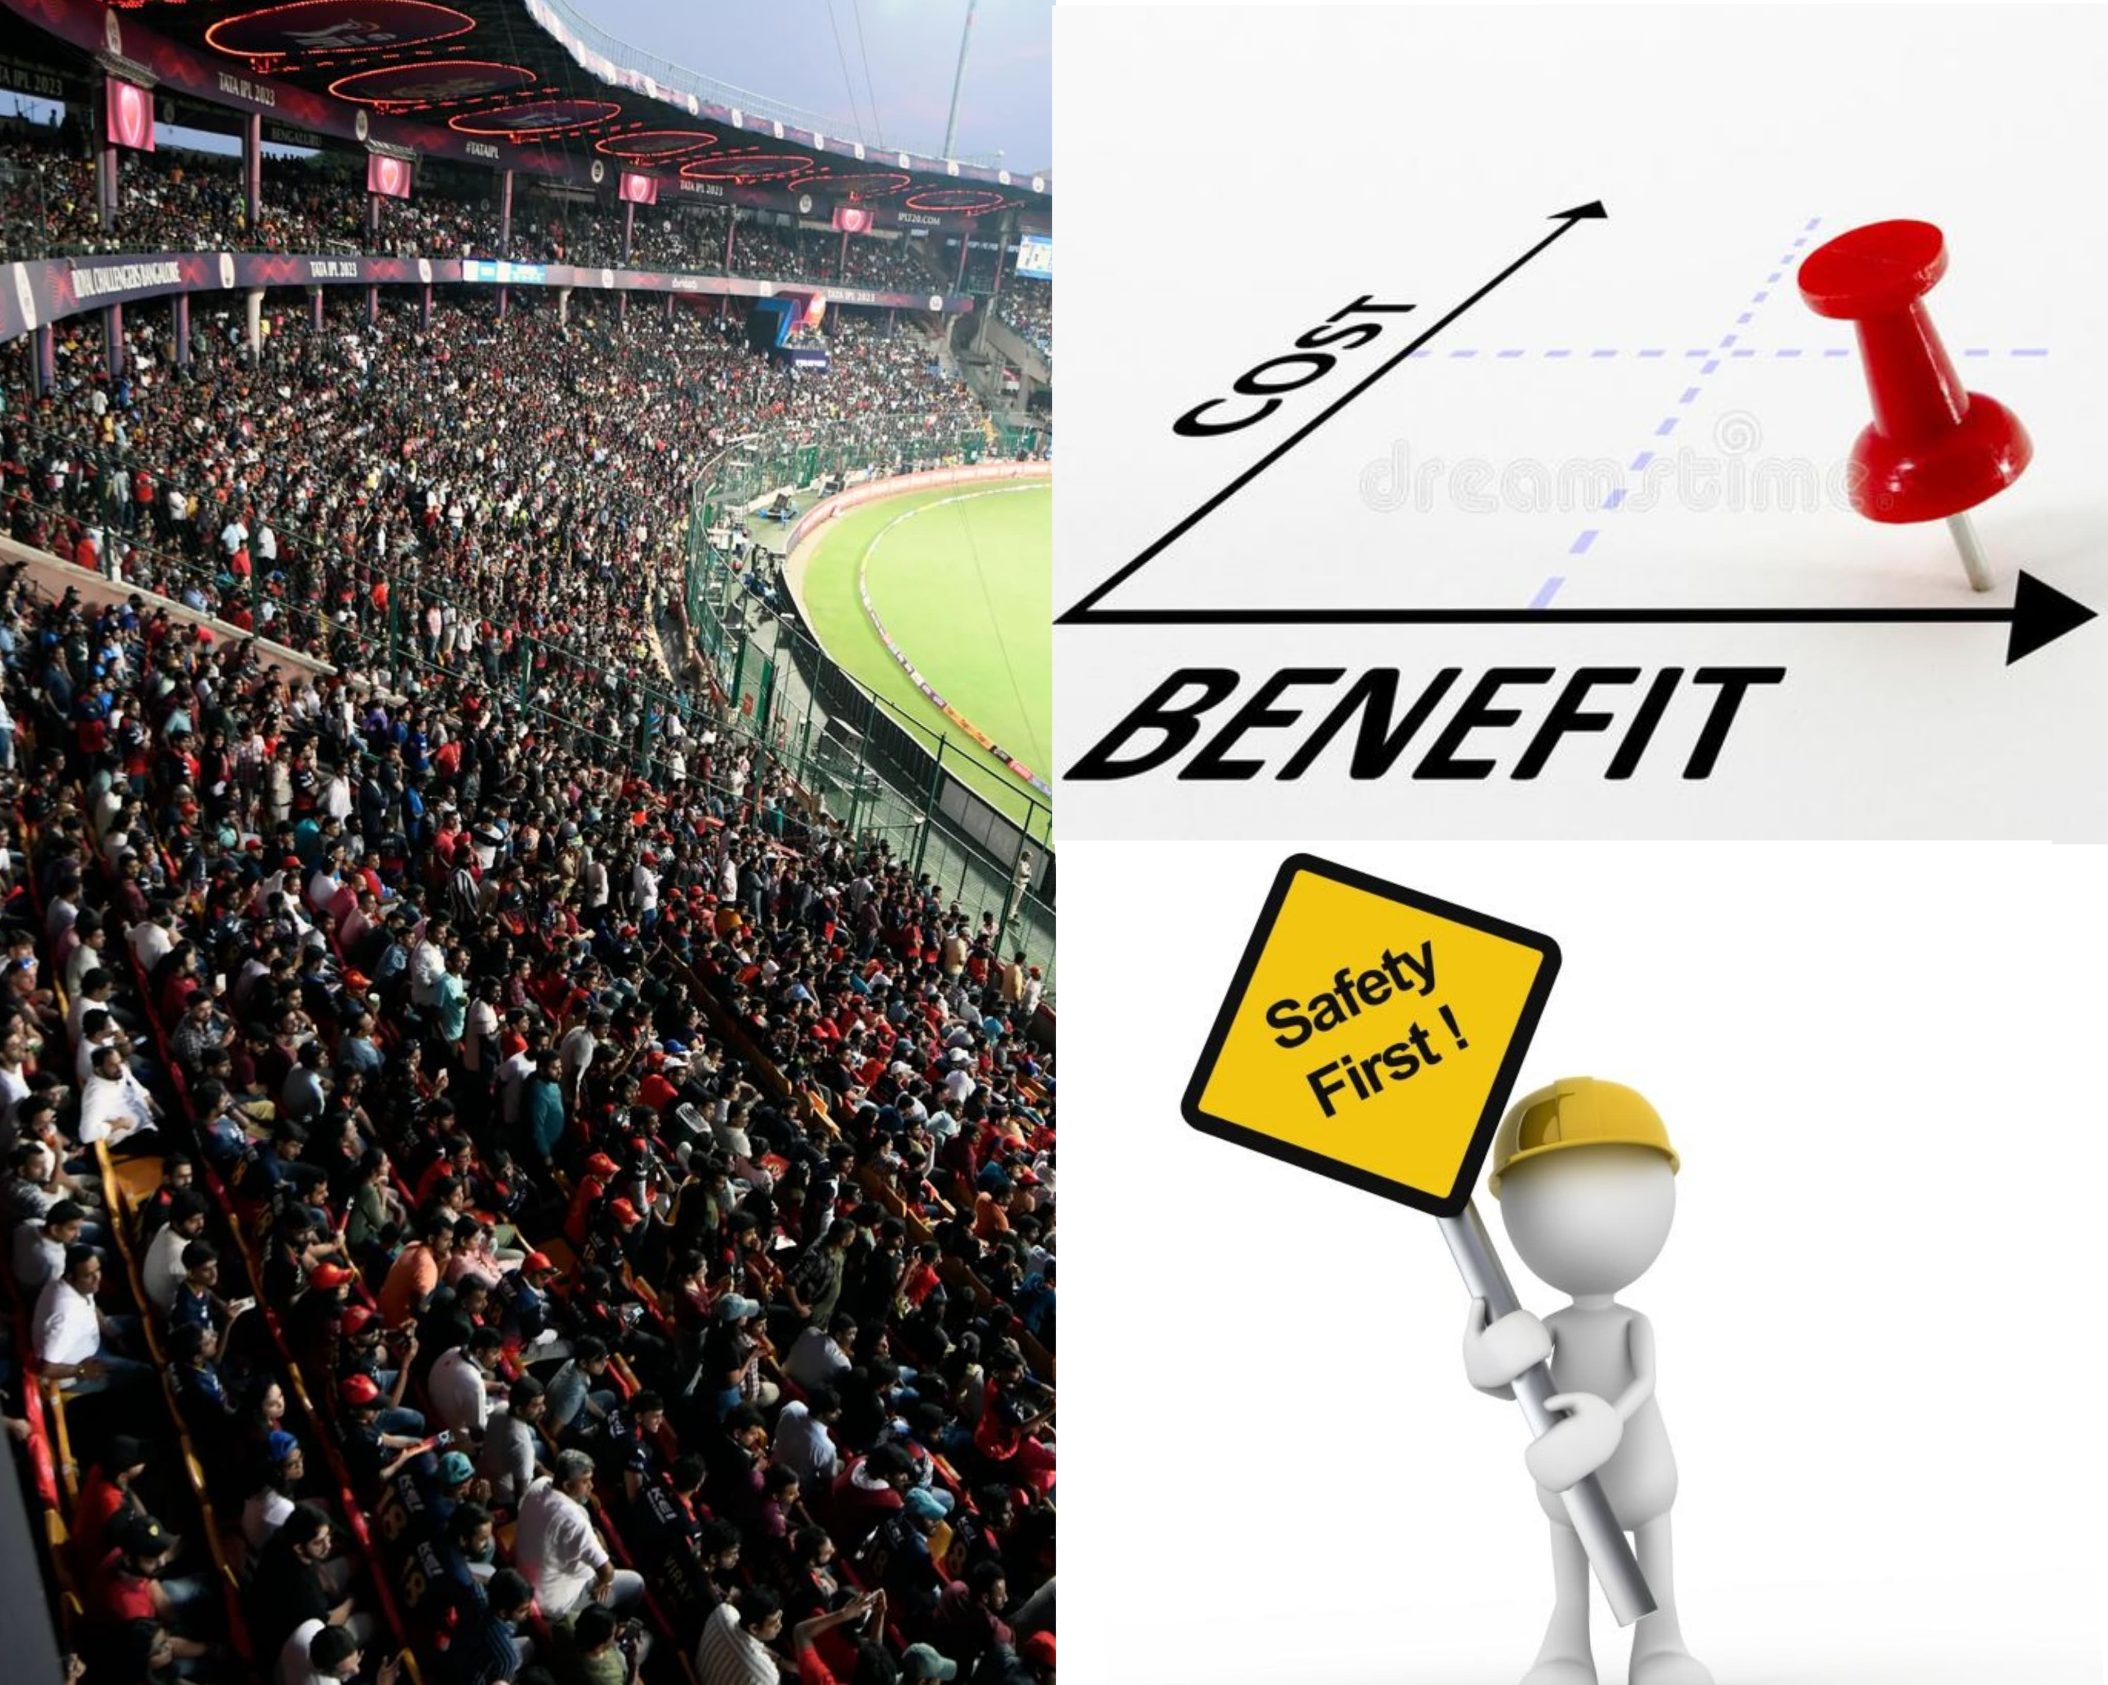
Benefits & Advantages
Prevents Overcrowding & Stampedes :
Provides early warnings to prevent dangerous situations caused by overcrowding.
Cost-Effective & Portable :
Runs on Raspberry Pi, making it affordable and easy to deploy in various locations.
Real-Time Processing :
Operates locally on the edge, ensuring fast and reliable performance without cloud dependency.
Customizable & Scalable :
Can be tailored to specific use cases (e.g., malls, stadiums, transport hubs).
Enhanced Public Safety :
Enables quick responses to potential risks, ensuring the safety of individuals in crowded areas.

Slide 5
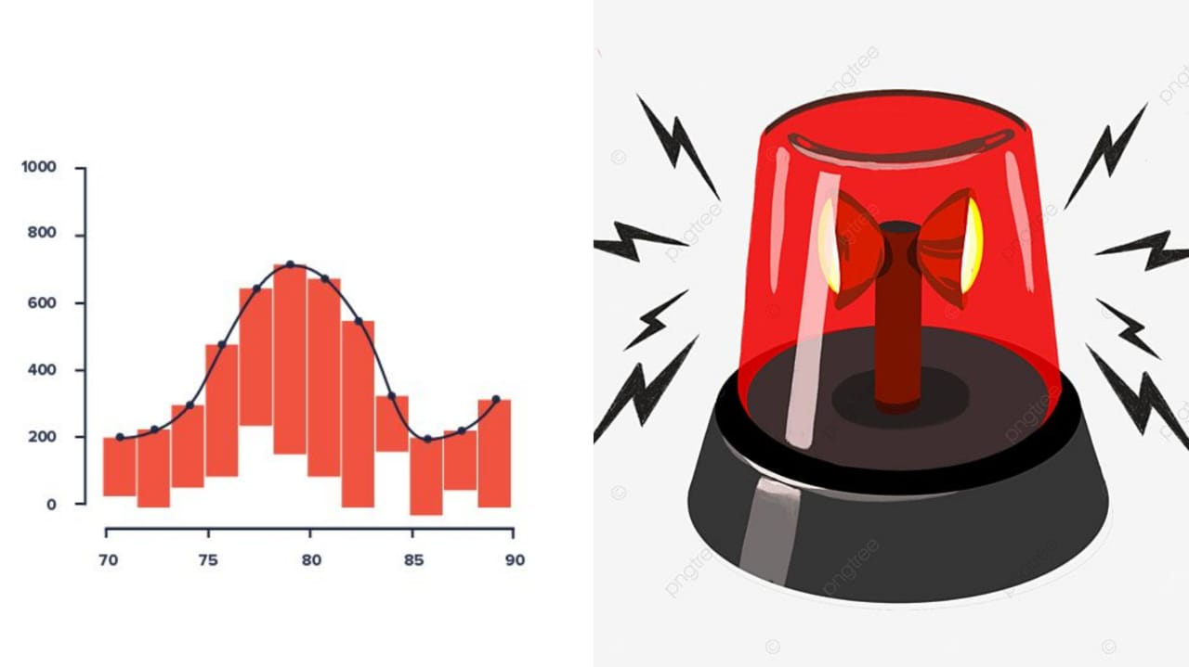
Future Enhancements
Advanced Heatmap Visualization :
Gradient-based heatmaps for better congestion zone identification.
IoT Integration :
Automated crowd control using IoT devices (e.g., LED indicators, alarms).
SMS/WhatsApp Alerts :
Extend alert mechanisms for broader reach.
AI-Based Movement Analysis :
Analyze crowd movement patterns to detect anomalies.
Historical Data Logging :
Store data for trend analysis and predictive modeling.

Slide 6
Conclusion
Summary :
Our AI-Based Crowded Area Risk Prediction System provides a cost-effective, real-time solution for crowd monitoring and risk management.
It ensures public safety by preventing overcrowding and enabling quick responses to potential risks.
Impact :
This system has the potential to revolutionize crowd management in public spaces, making them safer and more secure. Let’s work together to create safer public spaces!

Slide 7
Thank You

